Slide 1



CLOUD DATA ENGINEERING · MACHINE LEARNING
End-to-End Nifty Stock Forecasting Pipeline
A production-oriented pipeline delivering automated, explainable next-day price forecasts for HDFC stock using Azure-native services, Databricks, and reproducible model evaluation.
A Cloud-Native End-to-End Data & ML Pipeline using Medallion Architecture on Azure
PROJECT MEMBERS
PROJECT GUIDE
Asrar G. Sheikh
Dr. Shantanu Pathak
PRN: 260241225004
Project Guide
Vrushabh K. Urkudkar
PRN: 260241225055

Slide 2




Problem Statement
Why this project was undertaken.
Manual and Inconsistent
Manual stock analysis is time-consuming, inconsistent, and hard to reproduce.
No Automated Pipeline
No automated pipeline existed to ingest, validate, and forecast HDFC stock data on a daily cadence.
Ad-Hoc Notebooks
Analysts relied on ad-hoc notebooks which caused duplicated effort, stale data, and inconsistent model versions.
The Goal
Build a repeatable, production-style workflow that ingests, cleans, features, forecasts, and stores results daily.
HDFC STOCK PRICE FORECASTING PIPELINE
02

Slide 3

Business Problem
What real-world decision this pipeline supports.
Traders and analysts need timely, reliable next-day price signals to support intraday decisions and position management. Manual model runs do not scale, introduce errors, and result in stale forecasts.
This pipeline automates ingestion → cleaning → feature engineering → forecasting to deliver a fresh, auditable, explainable next-day forecast every day.
Ingestion
Cleaning
Feature Engineering
Forecasting
HDFC STOCK PRICE FORECASTING PIPELINE
03

Slide 4





Project Overview & Objectives
We implemented a cloud-native medallion pipeline on Azure to operationalize HDFC stock forecasting with both deep learning and statistical baselines, reproducible runs, and automated evaluation.
01
02
03
04
05
Ingest
Clean & Transform
Scale
Feature Generation
Forecast
Automate scheduled stock data ingestion (daily).
Standardize, validate, and deduplicate raw data.
Cloud-native processing using Databricks and ADLS Gen2.
Time-series features and rolling statistics.
Predict next-day price using LSTM and Prophet; compare and store results.
HDFC STOCK PRICE FORECASTING PIPELINE
04

Slide 5



Dataset Details
Figures below are illustrative placeholders — replace with your actual dataset statistics.
3500+
7
Daily
Yahoo Finance
ROWS
COLUMNS
FREQUENCY
SOURCE
Columns
Date · Open · High · Low · Close · Adj Close · Volume
Date Range
2016-01-01 to 2021-12-31 (example historic window)
HDFC STOCK PRICE FORECASTING PIPELINE
05

Slide 6



Exploratory Data Analysis (EDA)
Illustrative findings — replace with conclusions from your actual EDA.
Missing Values
~0.4% missing dates/rows; handled by forward-fill and removal of orphan rows in the Silver layer.
Closing Price Trend
Overall upward trend with periodic corrections; evidence of multi-year growth and short-term volatility.
Daily Returns Distribution
Heavy tails with occasional large negative/positive returns — outlier days flagged for separate review.
OHLC Correlation
Open/High/Low/Close correlation > 0.98, expected for price series; Volume weakly correlated with return magnitude.
Volatility
Identifiable high-volatility episodes aligned with market events; treated with winsorization for stable features.
HDFC STOCK PRICE FORECASTING PIPELINE
06

Slide 7


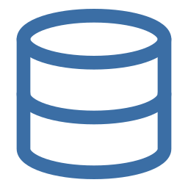


Technology Stack
The Azure-native services and frameworks behind each pipeline stage.
Apache Airflow
Azure Data Factory
Databricks
Workflow orchestration — DAG scheduling, retries.
Pipeline scheduling & data movement between services.
Distributed data processing and model training.
Azure Data Lake Storage Gen2
PySpark
LSTM
Bronze / Silver / Gold medallion storage.
Large-scale data transformation and feature engineering.
Deep learning time-series forecasting (sequence modelling).
Prophet
Robust statistical forecasting baseline.
HDFC STOCK PRICE FORECASTING PIPELINE
07

Slide 8
Why These Technologies
Reasoning, advantages, and limitations behind each core choice.
Component | Reason | Advantage | Limitation
Azure Data Lake + ADF | Native Azure scalability for storage and movement | Pay-as-you-go, managed infra, seamless with Azure services | Vendor lock-in
Databricks + PySpark | Distributed processing for time-series ETL and training | Fast Spark transforms, scalable clusters | Cluster cost/overhead for small datasets
Apache Airflow | Flexible, programmable DAG-based orchestration | Rich monitoring and retry semantics | Operational overhead to maintain
LSTM | Captures long-term temporal dependencies | Models non-linear patterns effectively | Needs more data and tuning; slower to train
Prophet | Fast, interpretable baseline for trend and seasonality | Robust to missing data; quick to train | Less accurate on complex non-linear patterns
HDFC STOCK PRICE FORECASTING PIPELINE
08

Slide 9

Architecture — Medallion Design
BRONZE
SILVER
GOLD
Raw Data
Cleaned Data
Analytics Data
Raw HDFC stock data ingested as-is.
Cleaned, standardized data with deduplication.
Engineered features, forecasts, and evaluation metrics.
Storage: Azure Data Lake Storage Gen2 · Processing: Databricks · Orchestration: Airflow + Azure Data Factory
HDFC STOCK PRICE FORECASTING PIPELINE
09

Slide 10


Pipeline Flow (Daily)
1. Trigger ADF
Airflow DAG triggers the Azure Data Factory pipeline on a daily schedule.
2. Ingest Bronze
Raw HDFC stock data is fetched and landed in the Bronze layer.
3. Clean to Silver
Data is cleaned, standardized, and deduplicated into the Silver layer.
4. Feature & Train
Time-series features are engineered; LSTM and Prophet models are trained.
5. Gold Forecasts
Next-day forecasts and evaluation metrics are written to the Gold layer.
HDFC STOCK PRICE FORECASTING PIPELINE
10

Slide 11
Model Comparison — LSTM vs Prophet
Metrics marked [ ] are illustrative — replace with your actual evaluation results.
Metric | LSTM | Prophet
Type | Deep learning (RNN sequence model) | Statistical additive model
What It Captures | Non-linear temporal patterns | Trend + seasonality
Training Time | Higher | Lower
Interpretability | Lower | Higher
Data Requirement | More historical data needed | Works well with less data
Sample Gold layer output (hdfc_forecast.csv): 2026-08-08, HDFCBANK.NS → prophet_forecast: 896.94 · lstm_forecast: 748.75 · model_used: prophet_lstm
HDFC STOCK PRICE FORECASTING PIPELINE
11

Slide 12
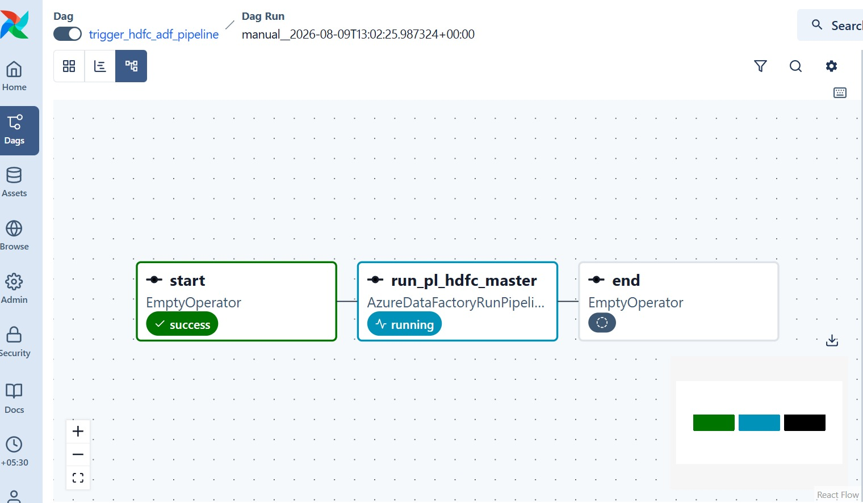
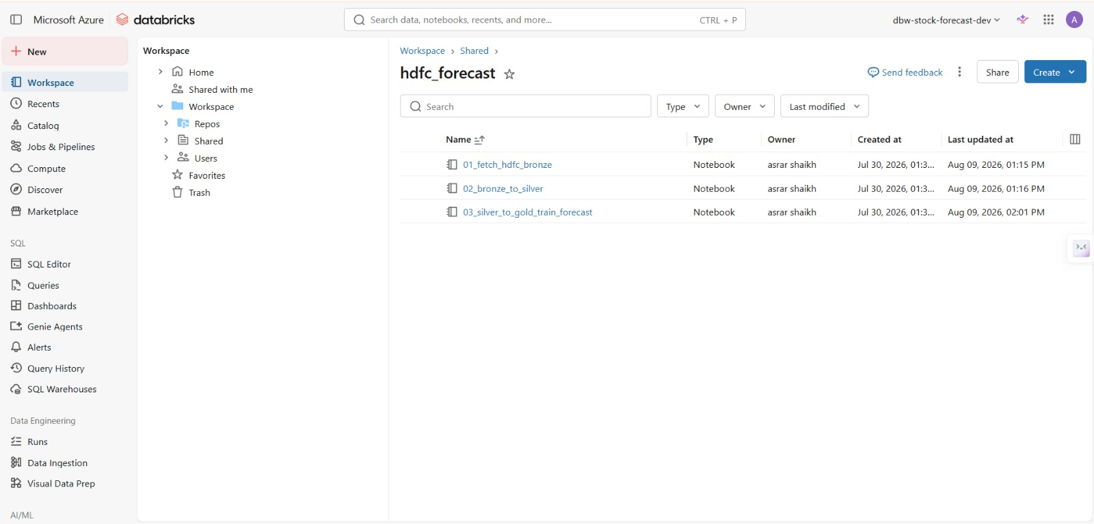
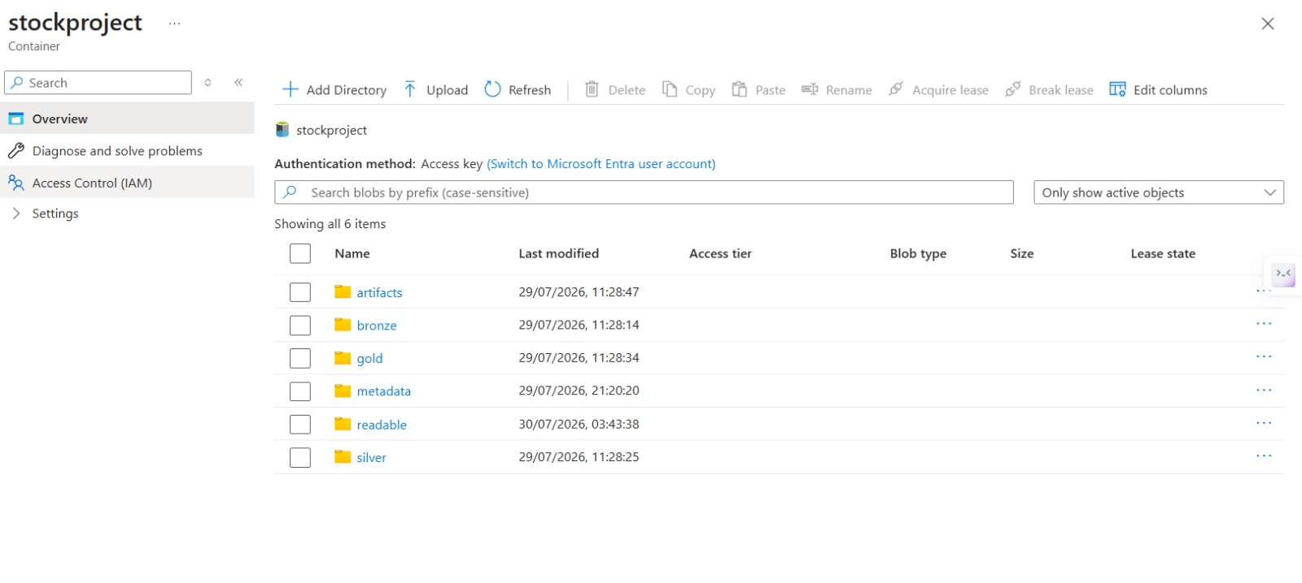
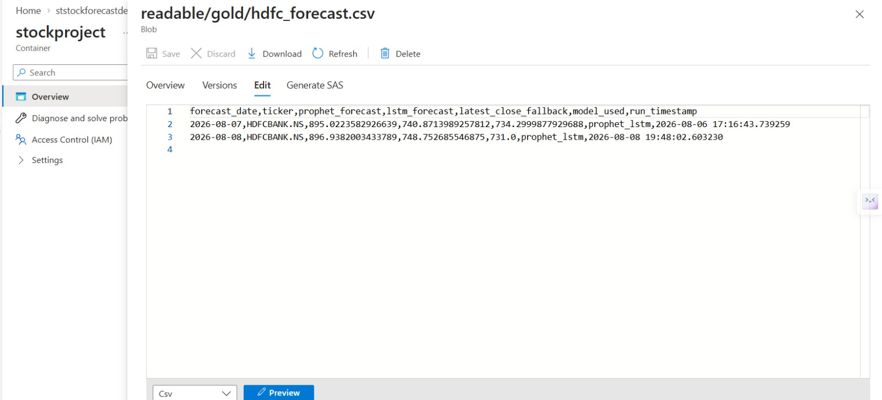
Deployment & Screenshots
An Airflow DAG on a daily schedule triggers the Azure Data Factory pipeline, which invokes Databricks notebooks for each medallion stage, with final forecasts written to the readable Gold layer.
Airflow DAG Run
Databricks Notebooks
trigger_hdfc_adf_pipeline — start → run_pl_hdfc_master (ADF) → end
01_fetch_hdfc_bronze → 02_bronze_to_silver → 03_silver_to_gold_train_forecast
ADLS Storage Layout
Gold Layer Forecast Output
bronze / silver / gold / readable containers in stockproject
readable/gold/hdfc_forecast.csv — Prophet + LSTM outputs
HDFC STOCK PRICE FORECASTING PIPELINE
12

Slide 13

Quality Assurance & Testing
Practices that keep the pipeline reliable in production.
Data Validation
Row count, null, and schema checks before promoting Bronze → Silver.
Exception Handling
Try/except with retry logic wrapped around every Airflow task.
Watermark Checkpointing
Prevents duplicate or partial writes if a run fails midway.
Unit Testing
Feature engineering functions validated for expected output shape and values.
Logging
Every pipeline stage logs progress and errors for traceability and debugging.
15

